Slide 1

Sprocket Central Pty Ltd
Data analytics approach
Monifa Sultana

Slide 2
Note: The data and information in this document is reflective of a hypothetical situation and client. This document is to be used for KPMG Virtual Internship purposes only.
Agenda
Introduction
Data Exploration
Model Development
Interpretation

Slide 3
Introduction
Identify and suggest the top 1000 customers to focus on from the Datasets.
Outline of problem
Sprocket Central is a company renowned for its premium bicycles and cycling accessories.
The marketing team aims to enhance business sales by examining the provided dataset.
By utilizing the provided three datasets, the goal is to analyze and recommend 1000 potential customers that Sprocket Central should prioritize to increase the company's overall value..
New and Old costumers age distribution
Wealth Segmentation by age group
Bike related purchase over past 3 years by gender and age group
Customer distribution by State
Number of car own by industry category
Contents of Data analysis

Slide 4
Data Exploration
Data Quality Assessment and Cleaning.
Key issues for data quality assessment
Accuracy : Correct Values
Completeness : Data fields with values
Consistency : Values Free from Contradiction
Currency : Values up to date
Relevancy : Data item with value meta data
Validity : Data Containing Allowable Values
Uniqueness : Records that are Duplicated
Summary Table

Slide 5
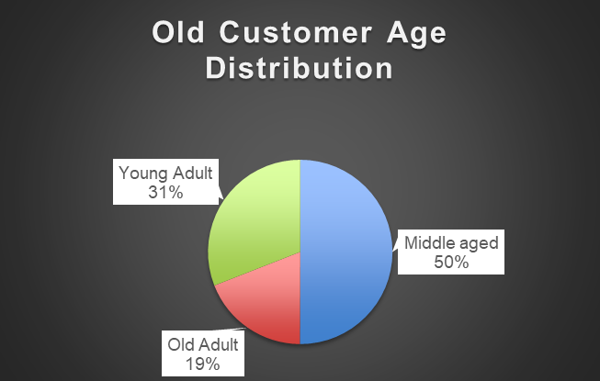
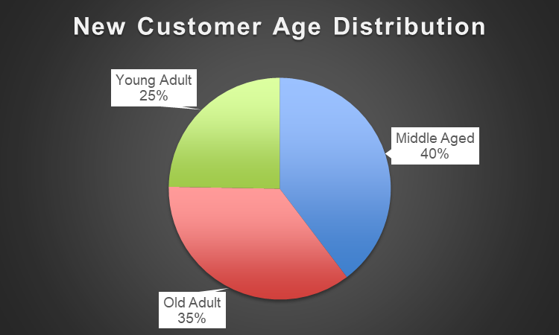
Model Development
New and Old Customers age distribution
Most of Customers are Middle aged almost 59% in “Old”. And in “New” 40% of customers are of Middle aged group.
31% of Customers are Young Adult in “Old”. And in “New” The lowest aged group Customers are young adult 25% .
The lowest aged group Customers are old aged 19% in “Old” and in “New” the percentage is 35%
Old aged are between 40-60 aged. Middle aged are between 40-60 aged. Young Adult aged are between 40-60 aged.

Slide 6
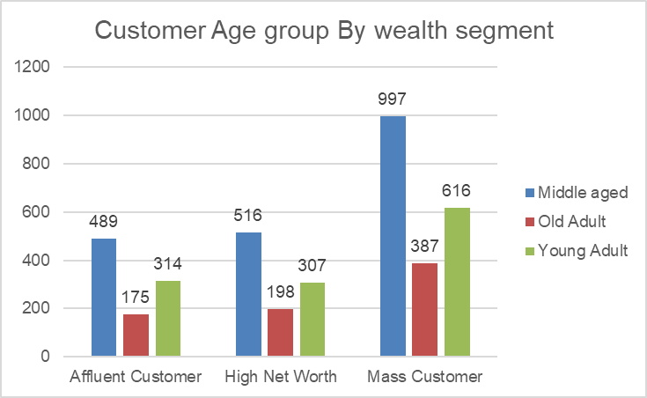
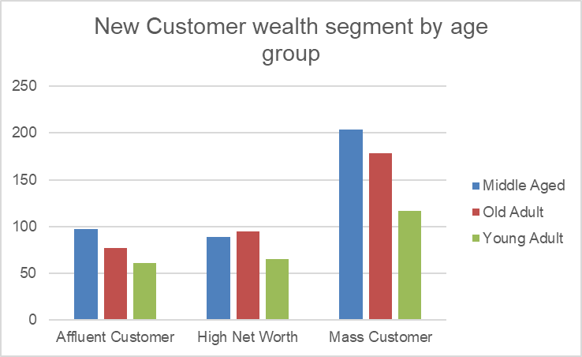
Model Development
Wealth Segmentation By age Group
The highest middle aged customers are Mass customer by wealth almost 997.
High net worth customer are also quite middle aged.
Young adult customer are larger then the old adult customer for both Affluent and high net.

Slide 7
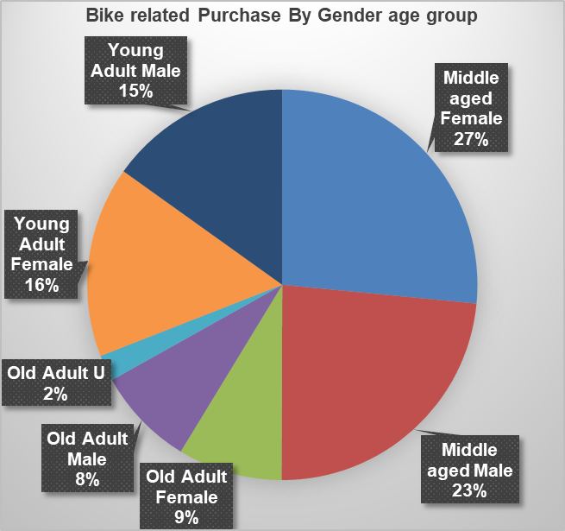
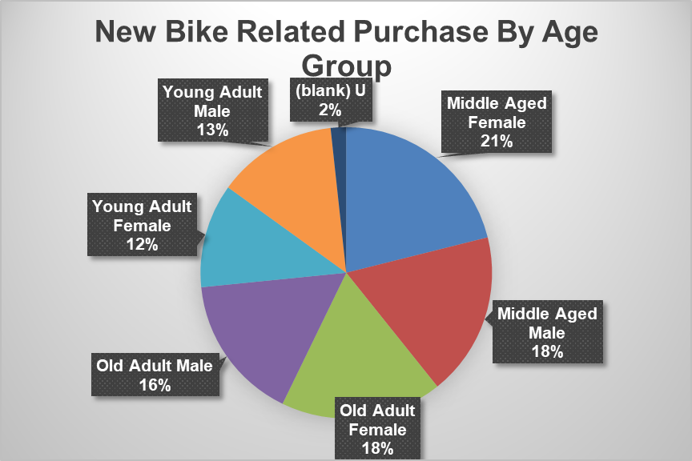
Model Development
Bike related purchases over last 3 years by Gender and Age group
Over the last 3 years about 27% and 16% of bike related purchase where made by middle aged and young adult female and male percentages are 23% and 15% .
The percentage in ‘New’ also similar to the old.
Numerically female purchases more then males.
Female make up majority of bike related sales.

Slide 8
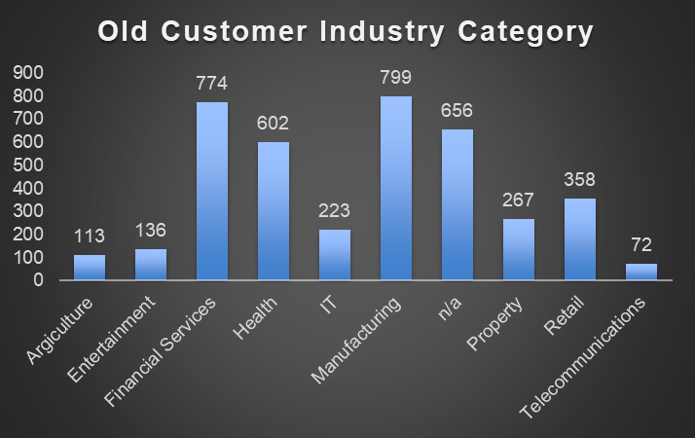
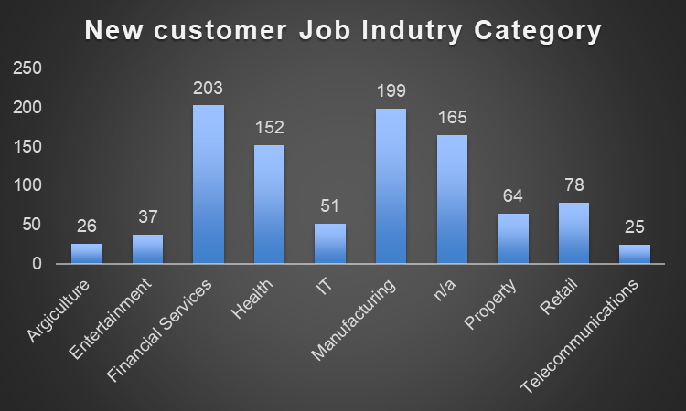
Model Development
Job Industry Distribution
The highest customers are from manufacturing industry in ‘Old’ and in ‘New’ the most customers are in Financial services.
The lowest number of Customers are from Agricultural and Telecommunication both in ‘New’ and ‘Old’.

Slide 9
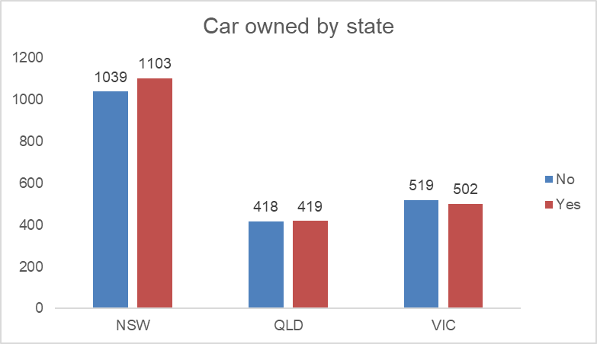
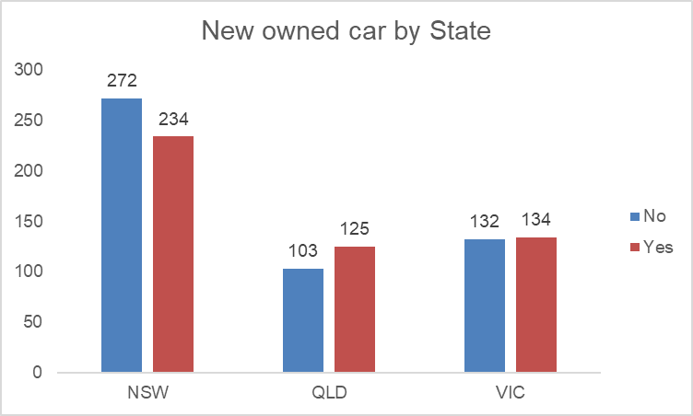
Model Development
Customer car owned by the state
NSW state has the highest customer has own car almost 1103 and also NSW state has the highest number customer has no car.
QLD has also good number of customers that have own car.
VIC relatively has similar rate of car owned by customer.

Slide 10
Model Development
RFM analysis and Customer Distributions
RFM analysis is used to target customers of a business to increase the revenue.
The RFM (Recency, Frequency, Monetary) model shows that have high level engagement to the business.

Slide 11
Model Development
Scatter plot based on Recency against monetary
The scatter plot shows that the customers who purchases most recently has generated most revenue .
The customer recency (100-200) also generated moderate revenue.
Lastly the customer who visited more then 200 days generated lowest revenue

Slide 12
Model Development
Scatter plot based on Frequency against monetary
The customer who selected as platinum are visited frequently which corelated with increased revenue for business .
There is a positive relation between frequency and monetary for business.

Slide 13
Model Development
Scatter plot based on Recency against Frequency
Very low frequency 0-2 correlated with high recency values. More than 200 days ago.
Customers who have visited recently has the higher chances of visit more frequently.
There is a negative relation between higher frequency with recent values for business.

Slide 14
Model Development
Customer Distributions
Platinum customers are visited frequently which keep an significant role in increasing revenue and almost 793 customers are platinum.
Gold customers are also most recent customer, bought very frequently, average money spent and keep moderate role in increasing revenue.
Silver customers not purchases frequently ,below RFM value.
Bronze customers has very low frequency, very low recency.

Slide 15
Interpretation
Customer title definition with RFM value.
Rank | Customer Title | Description | RFM Value | Number of Customer
1 | Platinum | Most recent, Buys often, spent most . | 443 | 793
2 | Gold | most recent customer, bought very frequently, average money spent | 311-411 | 877
3 | Silver | not purchases frequently ,below RFM value. | 212--311 | 815
4 | Bronze | very low frequency, very low recency. | 1-211 | 1010

Slide 16
Interpretation
Target Top 1000 Customer.
Rank | Customer Title | Description | RFM Value
1 | Platinum | Most recent, Buys often, spent most . | 443
2 | Gold | most recent customer, bought very frequently, average money spent | 311-411
1.Filter through the top 1000 customers by assigning the discussed in the table above.
2.The 1000 customer would have bought recently, they have bought very frequently in the past and tend to spend more than other customers.

Slide 17
Appendix

Slide 18
Appendix
This is an optional slide where you may place any supporting items.

